Slide 1
Part 2: Concepts in Java
Project: The Classic Snake game.

Slide 2
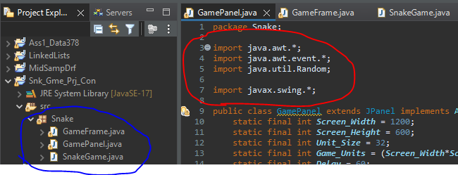
Java Graphics Class
In the previous slides we showed how python is more user friendly since it supports abstraction.
While Java supports abstraction to some degree(class has to be abstract or implements interface)
Here we will be seeing the other side of that coin, how by having a strict set rules for the languages syntax and semantics, it can help us write more efficient programs

Slide 3
Bad programmers worry about the code. Good programmers worry about data structures and their relationships.
-Linus Torvalds ( developer of Linux System)
Understanding the structure of the syntax and semantics can help us decrease the big Oh which means less work for the compiler, hence our program can do more with less code.
This will also make the program updatable, think of it as building a foundation of a building and going 1 level at a time, rather than mixing abstract elements in a functional way.
The first method will provide efficient code, while the second is guaranteed to have bugs.
The following is an example of how to create the classic snake game using the native java library, with 3 simple classes.
Note: we will not be using any foreign libraries such as libGDX, The libraries used are the following:
javax.Swing : GUI toolkit for java with multiple components(buttons, dialog boxes, etc..) used for crossplatform development due to efficiency.
-We will only be using the Jpanel and the Jframe classes from this library since our game is simple and consists of 2 states. Running = true/false. The game will be built in the panel class which is then passed on the frame class to be displayed on screen using the main class.(main class calls Jframe which calls Jpanel).
Java.awt & Java.awt.event: The awt library is used with the swing library to obtain dynamic application with real time changes, the java.awt.event classes handle the user input and the Java.awt classes commit runtime changes to the program based on the input events.
For our snake game we will be using the following:
event.ActionListener, event.ActionEvent, Event.KeyListener , event.KeyEvent
We will not be using the other classes since our input will only be 4 keyboard buttons: Up, down, left, right

Slide 4
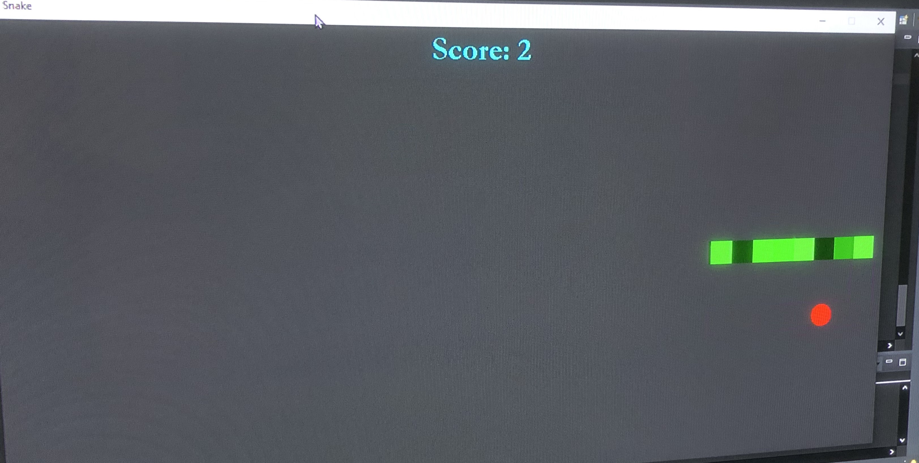
A demo

Slide 5
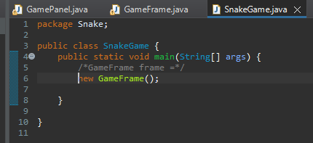

Slide 6
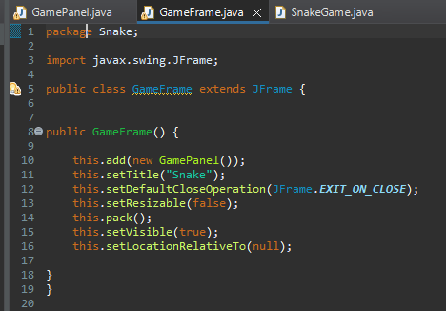

Slide 7
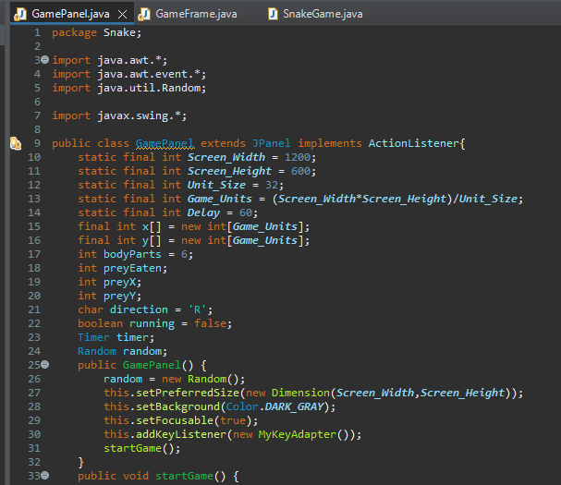

Slide 8
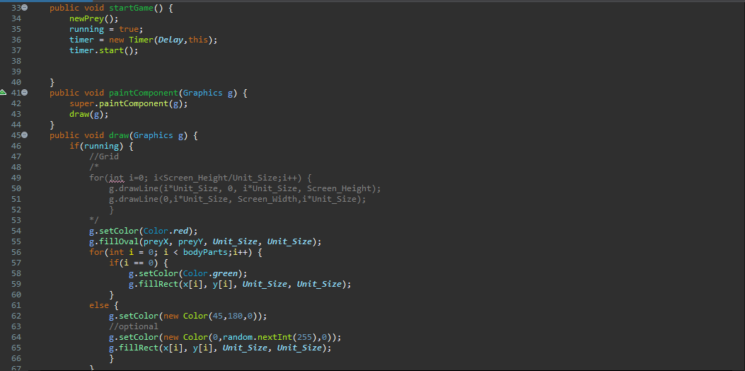

Slide 9
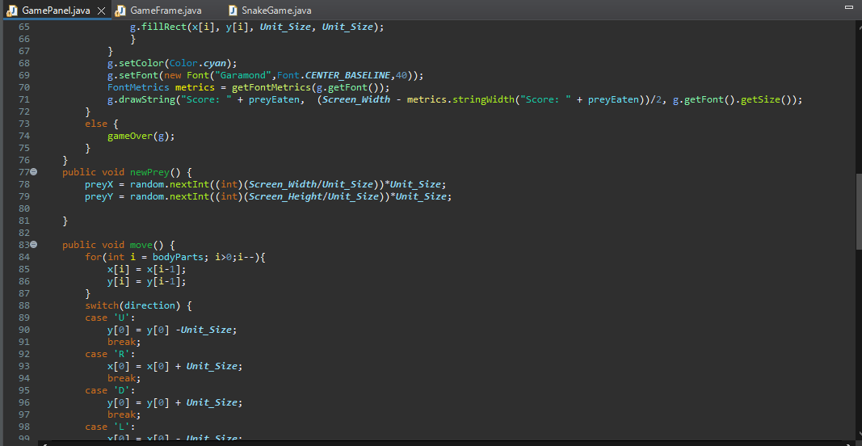

Slide 10
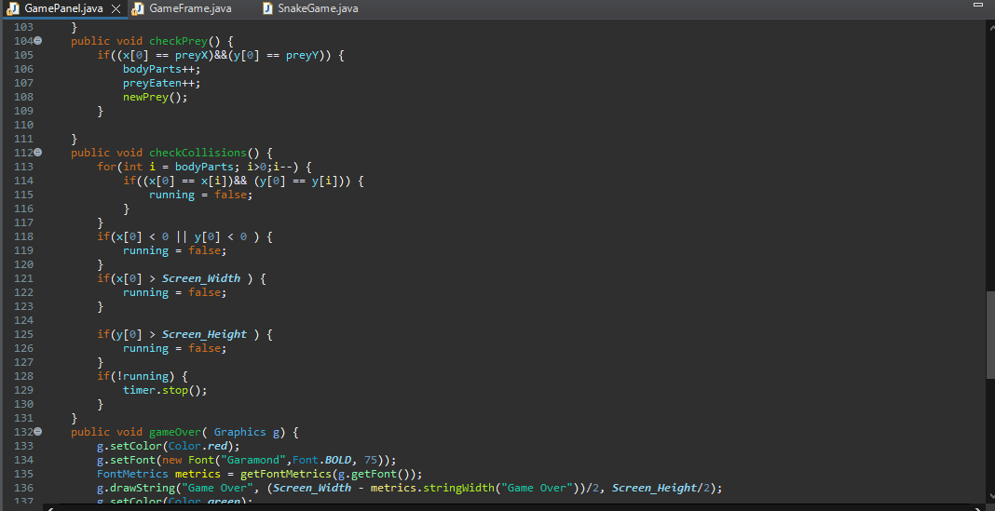

Slide 11
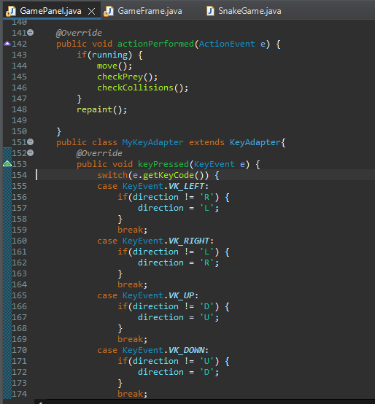

Slide 12
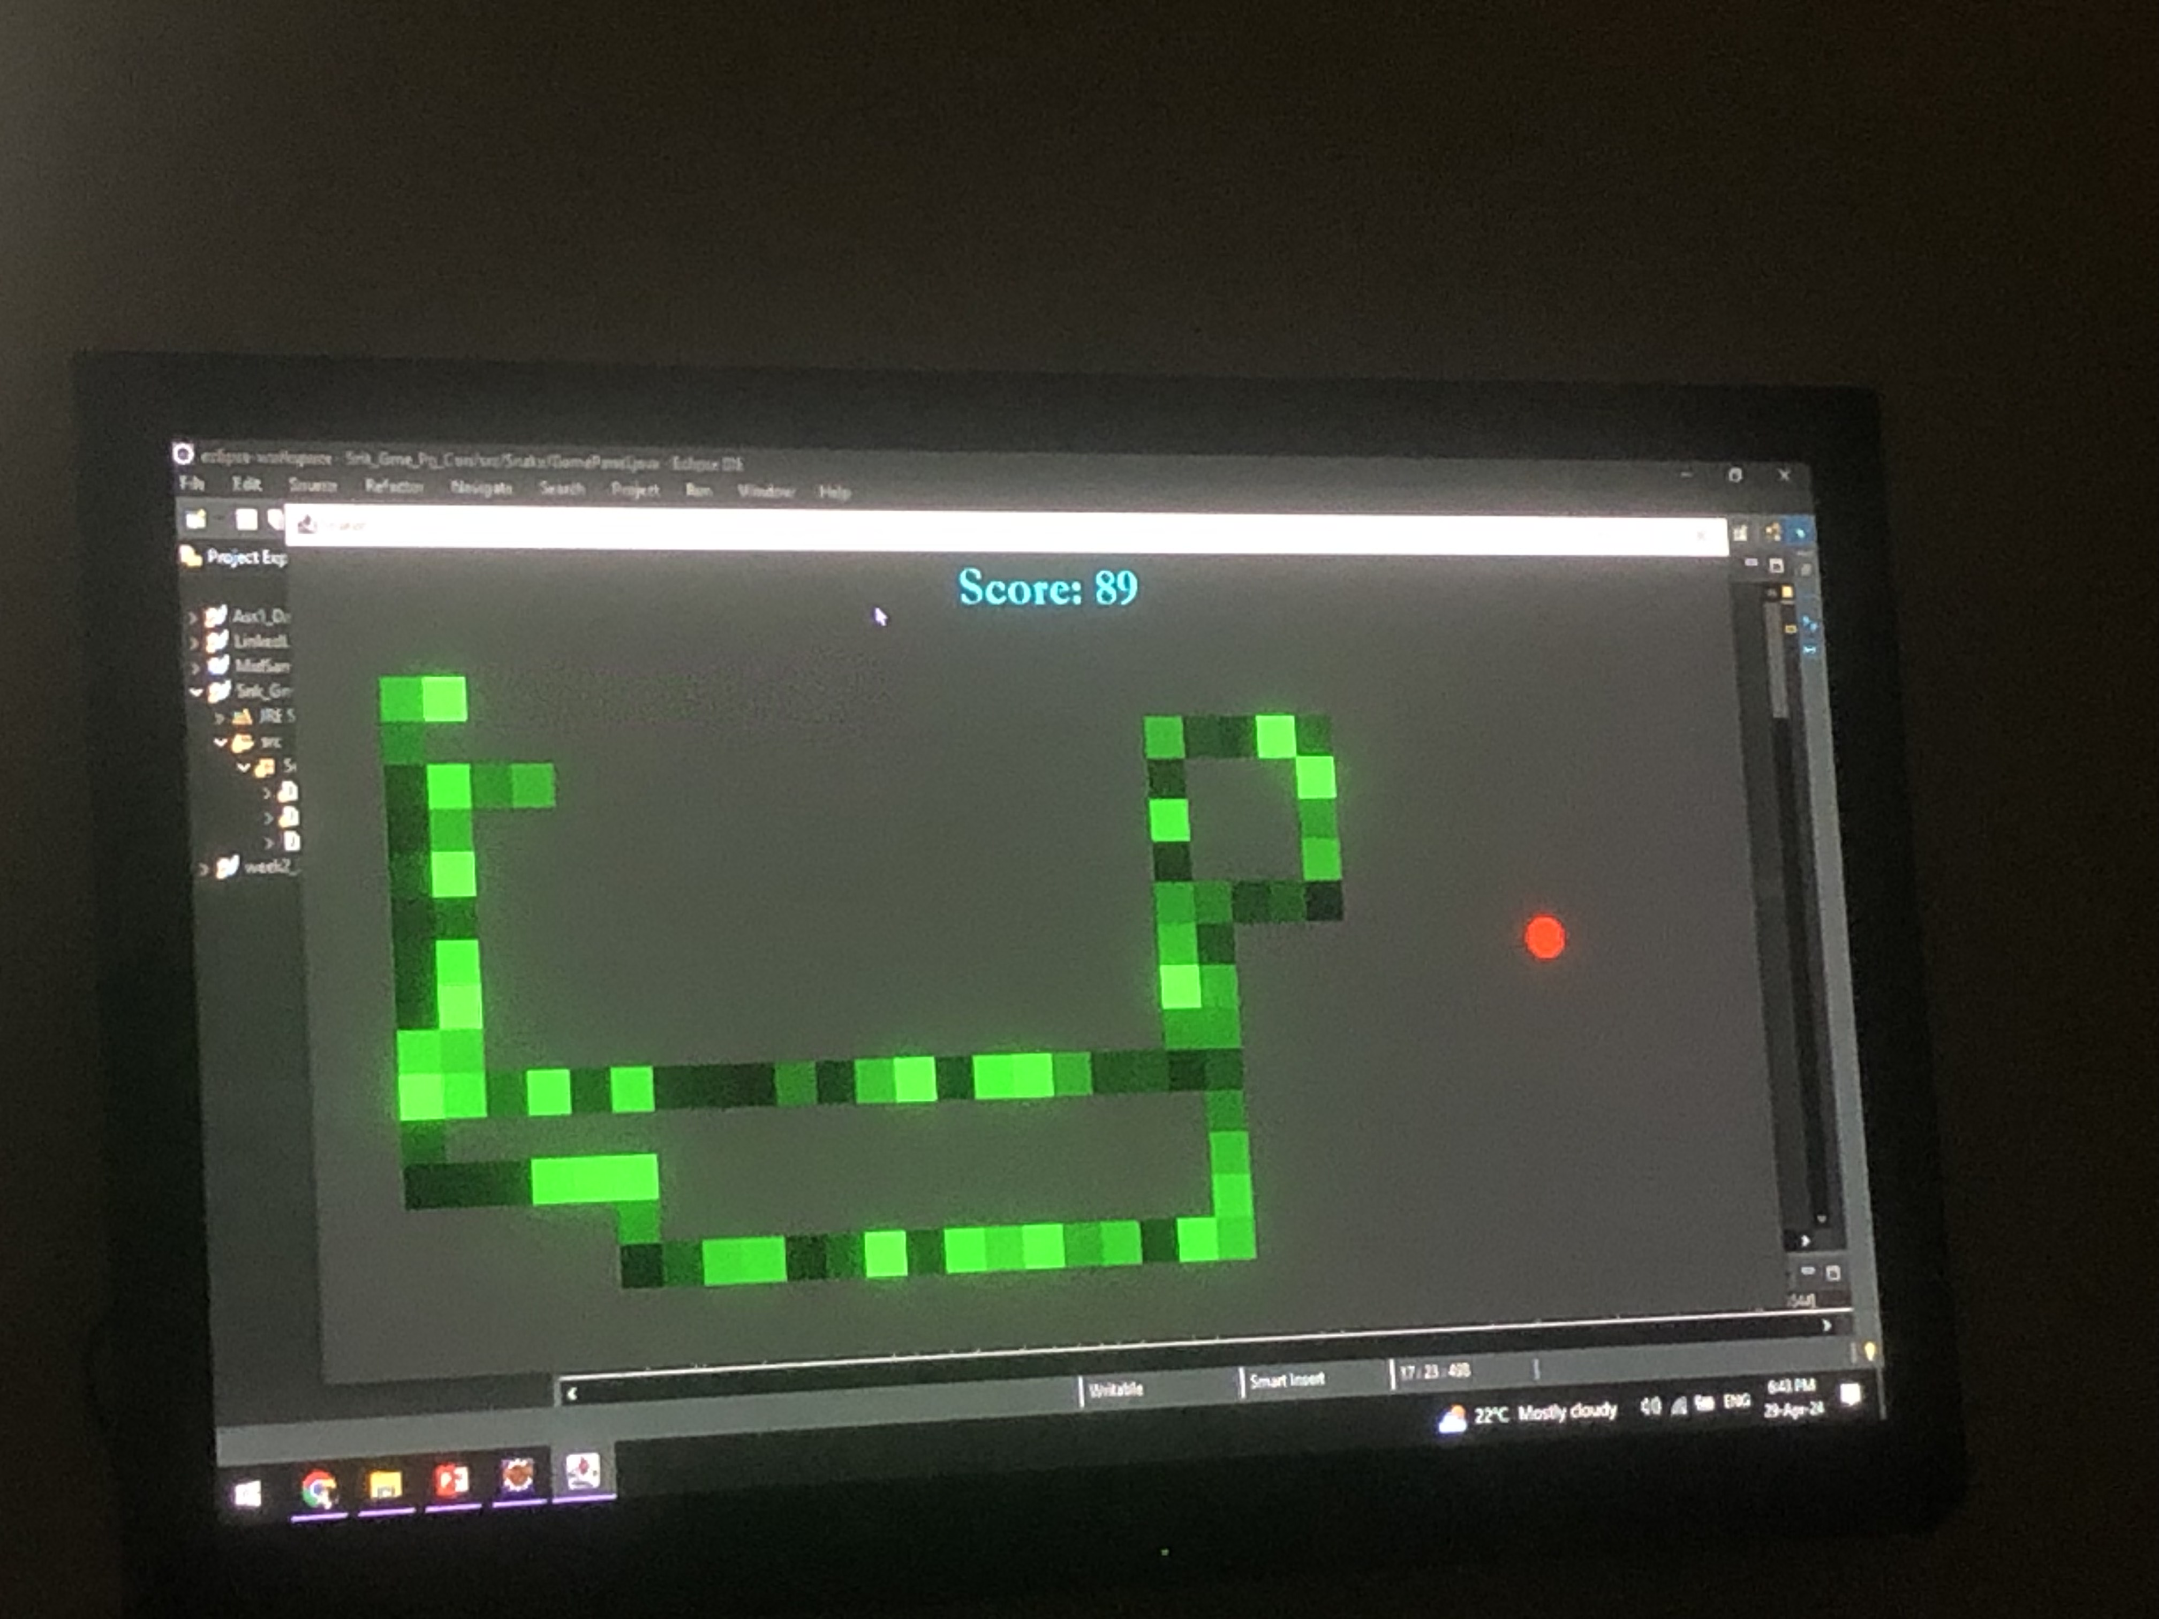
A great teacher cannot claim greatness, if he cannot beat his students at snake. -Mahatma Ghandi

Slide 13
